Slide 1
Accuracy and precision

Slide 2
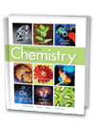

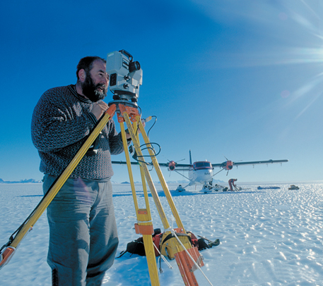
Chapter 3
Scientific Measurement
3.1 Using and Expressing
Measurements
Accuracy, Precision,
%Error

Slide 3
Learning Targets
      I can describe accuracy
      I can describe precision
      I can calculate percent error

Slide 4

Accuracy, Precision, and Error
Accuracy, Precision, and Error
  How do you evaluate accuracy and precision?

Slide 5
Accuracy, Precision, and Error
Accuracy and Precision
  In chemistry, the meanings of accuracy and precision are quite different.
  Accuracy is a measure of how close a measurement comes to the actual or true value of whatever is measured.
  Precision is a measure of how close a series of measurements are to one another, irrespective of the actual value.

Slide 6
Accuracy, Precision, and Error
Accuracy and Precision
  To evaluate the accuracy of a measurement, the measured value must be compared to the correct value.
  To evaluate the precision of a measurement, you must compare the values of two or more repeated measurements.

Slide 7
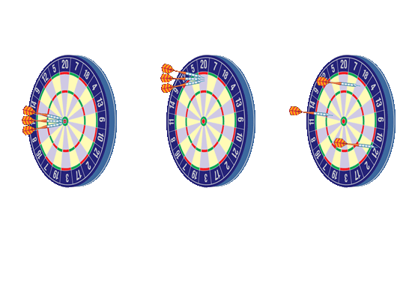
Accuracy, Precision, and Error
Accuracy and Precision
Darts on a dartboard illustrate the difference between accuracy and precision.
Good Accuracy, Good Precision
Poor Accuracy, Good Precision
Poor Accuracy, Poor Precision
The closeness of a dart to the bull’s-eye corresponds to the degree of accuracy. The closeness of several darts to one another corresponds to the degree of precision.

Slide 8
Accuracy, Precision, and Error
Determining Error
  Suppose you use a thermometer to measure the boiling point of pure water at standard pressure.
  The thermometer reads 99.1°C.
  You probably know that the true or accepted value of the boiling point of pure water at these conditions is actually
  100.0°C.

Slide 9
Accuracy, Precision, and Error
Determining Error
  There is a difference between the accepted value, which is the correct value for the measurement based on reliable references, and the experimental value, the value measured in the lab.
  The difference between the experimental value and the accepted value is called the error.
Error = experimental value – accepted value

Slide 10
Accuracy, Precision, and Error
Determining Error
    For the boiling-point measurement, the error is 99.1°C – 100°C, or –0.9°C.

Slide 11
Accuracy, Precision, and Error
Determining Error
  For the boiling-point measurement, the error is 99.1°C – 100°C, or –0.9°C.
  The percent error of a measurement is the absolute value of the measured experimental value minus the accepted value divided by the accepted value, multiplied by 100%.
⏐measured - accepted⏐
Percent error =
x
100%
accepted value

Slide 12

Sample Problem 3.2
Calculating Percent Error
The boiling point of pure water is measured to be 99.1°C. Calculate the percent error.
Think about it: Using the absolute value of the error means that percent error will always be a positive value.

Slide 13
Sample Problem 3.2
Calculate Solve for the unknown.
Substitute the equation for error, and then plug in the known values.
2
|experimental value – accepted value|
_______________________________
Percent error =
X 100%
accepted value
|99.1˚C – 100.0˚C |
=
X 100%
100.0 ˚C
0.9°C
_______
=
X 100 % = 0.9%
100.0°C

